Slide 1


Lecture # 03M
Arduino Interrupts
Prof. Dr. Engr. Muhibul Haque Bhuyan
Professor, Department of EEE
American International University-Bangladesh (AIUB)
Dhaka, Bangladesh

Slide 2
Interrupts
An interrupt is the automatic transfer of software execution in response to a hardware event that is asynchronous with the current software execution.
An interrupt is a signal emitted by a device attached to a computer or from a program within the computer. It requires the operating system (OS) to stop and figure out what to do next. An interrupt temporarily stops or terminates a service or a current process.
The hardware event can either be a busy to ready transition in an external I/O device (like the UART input/output) or an internal event (like bus fault, memory fault, or a periodic timer).

Slide 3
Introduction
Microcontroller normally executes instructions in an orderly fetch-execute sequence as dictated by a user-written program.
However, a microcontroller must also be ready to handle unscheduled events that might occur inside or outside the microcontroller.
The interrupt system onboard a microcontroller allows it to respond to these internally and externally generated events. By definition, we do not know when these events will occur.
When an interrupt event occurs, the microcontroller will normally complete the instruction it is currently executing and then will transfer the program control to an Interrupt Service Routine (ISR) that handles the interrupt.
Once the ISR is complete, the microcontroller will resume processing where it left off before the interrupt event occurred.

Slide 4
Interrupts
A request for the processor to ‘interrupt’ the currently executing process, so the event can be processed in a timely manner
Also referred to as ‘trap’
If the request is accepted: the processor suspends current processes, saves its states, and executes Interrupt Service Routine (ISR) or, Interrupt Handler
Concept of ‘Interrupt’ is very useful when implementing any of the switch debouncing methods.
Scheduled events are not interrupts

Slide 5
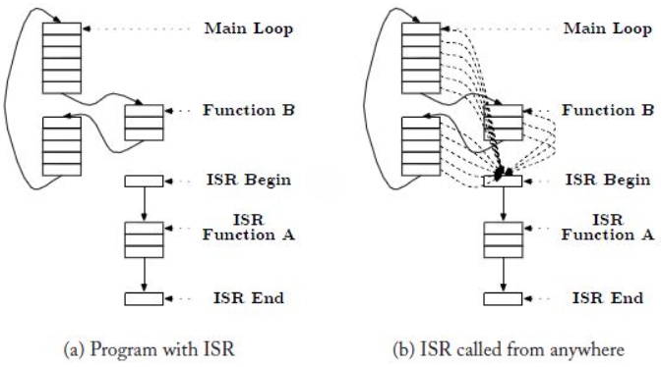
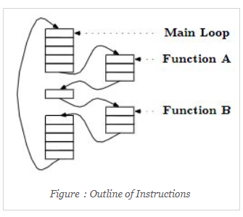
Introduction
Figure: Outline of Instructions
Figure: Outline of Instructions with ISR

Slide 6
Why do we need it?
Let’s think about a real-life example:
You are heating up your food using the microwave.
In this case, you can either:
Stare at the microwave while it heats up the food
Go about your life normally and go to the microwave when you get the signal that the food has been heated up
Which of the above-mentioned options do you think is more efficient?
Usually, we want to go about our life while the food is being heated up.
This is because we want to make efficient use of our time.
It is very similar for processors as well.
We hear the ting sound from the microwave, stop what we are doing, and go to take out the heated food.
This ‘ting’ sound is an interrupt.
Similarly, if the processor is waiting for some conditions to be fulfilled to perform a specific task (task 1):
It can wait and halt other processes till the conditions for that task is fulfilled.
It can execute the normal instructions and halt them for a brief time once the conditions for task 1 have been fulfilled, finish task 1 and go back to executing the main routine.
Clearly, the 2nd option is better for maximizing the processor’s resource utilization.
This is where interrupts come in handy.
When the conditions for task 1 has been met, it can simply trigger an interrupt, stop the main routine to complete the task and once finished go back to the main routine.

Slide 7
The Main Reasons You Might Use Interrupts
To detect pin changes (e.g., rotary encoders, button presses)
Watchdog timer (e.g., if nothing happens after 8 seconds, interrupt me)
Timer interrupts - used for comparing/overflowing timers
SPI data transfers
I2C data transfers
USART data transfers
ADC conversions (analog to digital)
EEPROM ready for use
Flash memory ready

Slide 8
Interrupt Vector
The interrupt vectors and vector table are crucial to the understanding of hardware and software interrupts. Interrupt vectors are addresses that inform the interrupt handler as to where to find the ISR (Interrupt Service Routine, also called Interrupt Service Procedure).
Misspelling the vector name (even wrong capitalization) will result in the ISR not being called and it will not also result in a compile error.

Slide 9
Interrupt Service Routines
Interrupt Service Routines are functions with no arguments. Some Arduino libraries are designed to call your own functions, so you just supply an ordinary function, e.g.,
// Interrupt Service Routine (ISR)
void pinChange ()
{
flag = true;
} // end of pinChange
As per the datasheet, the minimal amount of time to service an interrupt is 82 clock cycles in total. Assuming a 16 MHz clock, there would be 62.5 ns time needed per clock cycle. So, the total time required is 5.125 μs.

Slide 10
Interrupt Service Routines
When an ISR is entered, interrupts are disabled. Naturally, they must have been enabled in the first place, otherwise, the ISR would not be entered. However, to avoid having an ISR itself be interrupted, the processor turns interrupts off.
When an ISR exits, then interrupt are enabled again. The compiler also generates code inside an ISR to save registers and status flags, so that whatever you were doing when the interrupt occurred will not be affected.
However, you can turn interrupts on inside an ISR if you absolutely must.
// Interrupt Service Routine (ISR)
void pinChange (){
// handle pin change here
interrupts (); // allow more interrupts
} // end of pinChange

Slide 11
Interrupt Function of Arduino
Re-enables interrupts (after they’ve been disabled by noInterrupts()). Interrupts allow certain important tasks to happen in the background and are enabled by default. Some functions will not work while interrupts are disabled, and incoming communication may be ignored. Interrupts can slightly disrupt the timing of code, however, and may be disabled for particularly critical sections of code.
Syntax: interrupts() and noInterrupts(), all are opposite of interrupts()
Parameters: None
Returns: Nothing
Example Code: The code enables Interrupts.
void setup() {}
void loop() {
noInterrupts();
// critical, time-sensitive code here
interrupts();
// other code here
}

Slide 12
Global Enable
The main interrupt flag
This is used to turn all the interrupts on or off
Example: sei(); //globally enable interrupt
Available in the Status Register (SREG): Bit 7

Slide 13
Atmega328p Interrupt Vector Table
The ATmega328P provides support for 25 different interrupt sources. These interrupts and the separate Reset Vector each have a separate program vector located at the lowest addresses in the Flash program memory space.
The complete list of “Reset and Interrupt Vectors” in ATMega328P is shown in this table. Each Interrupt Vector occupies two instruction words.
The list also determines the priority levels of the different interrupts. The lower the address the higher is the priority level. RESET has the highest priority, and next is INT0 – the External Interrupt Request 0.

Slide 14
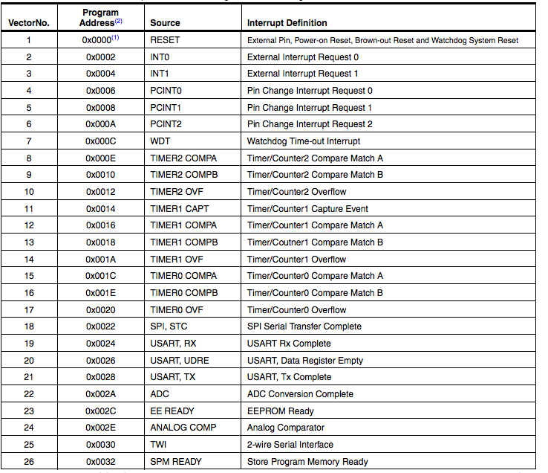
Atmega328p Interrupt Vector Table
This has the highest level of interrupt priority

Slide 15
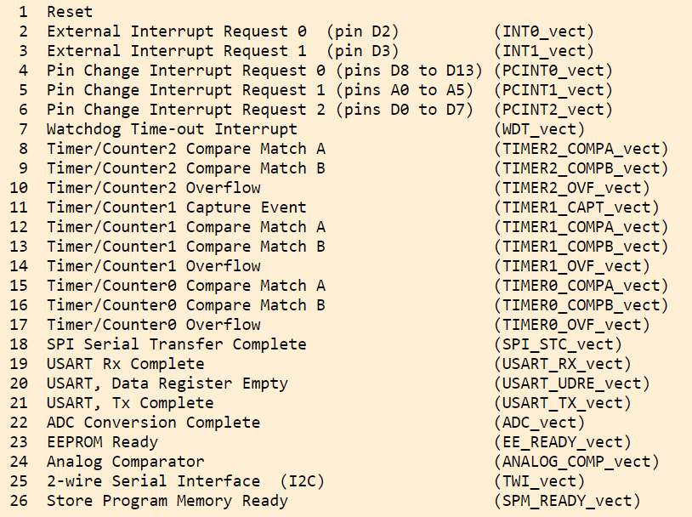
List of interrupts, in priority order, for the ATmega328p:

Slide 16
Trigger
An asynchronous event that causes the interrupt
For example, the push button press during experiment 4 in our MES Lab can be a trigger.
It can cause an interrupt that is registered by the module and is reacted to.
What if all the conditions are not met but a trigger flag is set?
In this case, rather than the request being dismissed, it is held pending and postponed until a later time.
What happens after a trigger? Once the interrupt is triggered and processed, the interrupt flag is cleared.
Clearing the interrupt flag is called acknowledgment.

Slide 17
Interrupt Service Routine (ISR)
The module that is executed when hardware requests an interrupt.
There may be 1 large ISR handling all the interrupt requests, or many small ISRs handling the many interrupts (interrupt vectors).
Example:
ISR(TIMER0_OVF_vect) // enabling overflow vector inside Timer0 using an ISR
ISR(TIMER0_COMPA_vect) // This is the Timer0 Compare ‘A’ interrupt service routine.
Remember, the ISR is a separate routine and requires a separate flowchart to represent.

Slide 18
General Rules for ISR
The ISR should execute as fast as possible.
The interrupt should occur when it’s time to perform the required action
The ISR should perform the action
The ISR should end and return to the main function right away.
Placing backward branches (busy, wait, iterations) inside the ISR should be avoided.
The percentage of time spent executing ISR should be small when compared to the time between interrupt triggers.

Slide 19
General Rules while writing an Interrupt Service Routine (ISR):
Keep it short
Don't use delay ()
Don't do serial prints
Make variables shared with the main code volatile
Variables shared with the main code may need to be protected by "critical sections" (see below)
Don't try to turn interrupts off or on

Slide 20
What are "volatile" variables?
Variables shared between ISR functions and normal functions should be declared "volatile". This tells the compiler that such variables might change at any time, and thus the compiler must reload the variable whenever you reference it, rather than relying upon a copy it might have in a processor register.
volatile boolean flag;
// Interrupt Service Routine (ISR)
void isr()
{
flag = true;
} // end of isr

Slide 21
What are "volatile" variables?
void setup ()
{
attachInterrupt (digitalPinToInterrupt (2), isr, CHANGE); // attach interrupt handler
} // end of setup
void loop ()
{
if (flag)
{
// interrupt has occurred
}
} // end of loop

Slide 22
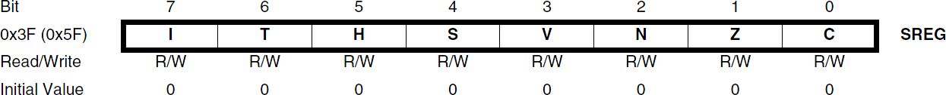
Atmega328p Interrupt Processing
When an interrupt occurs, the microcontroller completes the current instruction and stores the address of the next instruction on the stack.
It also turns off the interrupt system to prevent further interrupts while one is in progress. This is done by clearing the SREG Global Interrupt Enable I-bit.
The Interrupt flag bit is cleared for Type 1 Interrupts only (see the next Slide for Type definitions).

Slide 23
Atmega328p Interrupt Processing
The execution of the ISR is performed by loading the beginning address of the ISR specific for that interrupt into the program counter. The processor starts running the ISR.
Execution of the ISR continues until the Return from Interrupt instruction (RETI) is encountered. The SREG I-bit is automatically set when the RETI instruction is executed (i.e., Interrupts enabled).
When the processor exits from an interrupt, it will always return to the interrupted program and execute one more instruction before any pending interrupt is served.
The Status Register is not automatically stored when entering an interrupt routine, nor restored when returning from an interrupt routine. This must be handled by software.

Slide 24
Atmega328p Interrupt Processing – Type 1
The user software can write logic one to the I-bit to enable nested interrupts. All enabled interrupts can then interrupt the current interrupt routine.
The SREG I-bit is automatically set to logic one when a Return from Interrupt instruction (RETI) is executed.
There are basically two types of interrupts:
The first type (Type 1) is triggered by an event that sets the Interrupt Flag. For these interrupts, the Program Counter is vectored to the actual Interrupt Vector to execute the interrupt handling routine, and hardware clears the corresponding Interrupt Flag.

Slide 25
Atmega328p Interrupt Processing – Type 1
If the same interrupt condition occurs while the corresponding interrupt enables bit is cleared, the Interrupt Flag will be set and remembered until the interrupt is enabled, or the flag is cleared by software (interrupt canceled).
Interrupt Flag can be cleared by writing a logic one to the flag bit position(s) to be cleared.
If one or more interrupt conditions occur while the Global Interrupt Enable (SREG I) bit is cleared, the corresponding Interrupt Flag(s) will be set and remembered until the Global Interrupt Enable bit is set on return (RETI) and will then be executed by order of priority.

Slide 26
Atmega328p Interrupt Processing – Type 2
The second type (Type 2) of interrupts will trigger as long as the interrupt condition is present. These interrupts do not necessarily have Interrupt Flags. If the interrupt condition disappears before the interrupt is enabled, the interrupt will not be triggered.

Slide 27
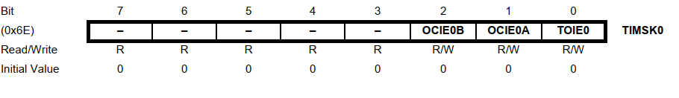
TIMSK0 – Timer/Counter0 Interrupt Mask Register
• Bits 7..3 – Res: Reserved Bits
These bits are reserved bits in the ATmega328P and will always read as zero.
• Bit 2 – OCIE0B: Timer/Counter Output Compare Match B Interrupt Enable
When the OCIE0B bit is written to one, and the I-bit in the Status Register is set, the Timer/Counter Compare Match B Interrupt is Enabled. The corresponding interrupt is executed if Compare Match in Timer/Counter0 occurs, i.e., when the OCF0B bit is set in the Timer/Counter Interrupt Flag Register, TIFR0.

Slide 28
TIMSK0 – Timer/Counter0 Interrupt Mask Register
• Bit 1 – OCIE0A: Timer/Counter0 Output Compare Match A: Interrupt Enable
When the OCIE0A bit is written to one, and the I-bit in the Status Register is set, the Timer/Counter0 Compare Match A interrupt is enabled. The corresponding interrupt is executed if a Compare Match in Timer/Counter0 occurs, i.e., when the OCF0A bit is set in the Timer/Counter 0 Interrupt Flag Register, TIFR0.
• Bit 0 – TOIE0: Timer/Counter0 Overflow Interrupt Enable
When the TOIE0 bit is written to one, and the I-bit in the Status Register is set, the Timer/Counter0 Overflow interrupt is enabled. The corresponding interrupt is executed if an overflow in Timer/Counter0 occurs, i.e., when the TOV0 bit is set in the Timer/Counter 0 Interrupt Flag Register – TIFR0

Slide 29
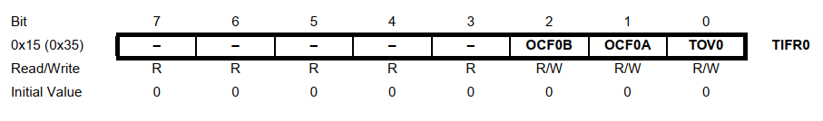
TIFR0 – Timer/Counter0 Interrupt Flag Register
• Bits 7..3 – Res: Reserved Bits
These bits are reserved bits in the ATmega328P and will always read as zero.
• Bit 2 – OCF0B: Timer/Counter 0 Output Compare B Match Flag
The OCF0B bit is set when a Compare Match occurs between the Timer/Counter and the data in OCR0B – Output Compare Register0 B. OCF0B is cleared by hardware when executing the corresponding interrupt handling vector. Alternatively, OCF0B is cleared by writing a logic one to the flag. When the I-bit in SREG, OCIE0B (Timer/Counter Compare B Match Interrupt Enable), and OCF0B are set, the Timer/Counter Compare Match Interrupt is executed.

Slide 30
TIFR0 – Timer/Counter0 Interrupt Flag Register
• Bit 1 – OCF0A: Timer/Counter 0 Output Compare A Match Flag
The OCF0A bit is set when a Compare Match occurs between the Timer/Counter0 and the data in OCR0A – Output Compare Register0. OCF0A is cleared by hardware when executing the corresponding interrupt handling vector. Alternatively, OCF0A is cleared by writing a logic one to the flag. When the I-bit in SREG, OCIE0A (Timer/Counter0 Compare Match Interrupt Enable), and OCF0A are set, the Timer/Counter0 Compare Match Interrupt is executed.

Slide 31
TIFR0 – Timer/Counter0 Interrupt Flag Register
• Bit 0 – TOV0: Timer/Counter0 Overflow Flag
The bit TOV0 is set when an overflow occurs in Timer/Counter0. TOV0 is cleared by hardware when executing the corresponding interrupt handling vector. Alternatively, TOV0 is cleared by writing a logic one to the flag. When the SREG I-bit, TOIE0 (Timer/Counter0 Overflow Interrupt Enable), and TOV0 are set, the Timer/Counter0 Overflow interrupt is executed.
The setting of this flag is dependent on the WGM02:0 bit setting

Slide 32
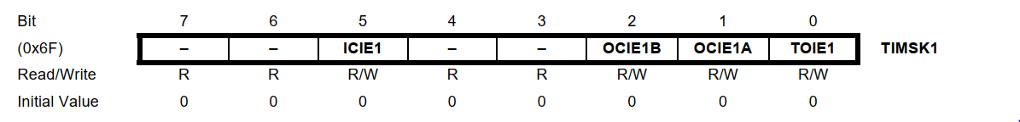
TIMSK1 – Timer/Counter1 Interrupt Mask Register
• Bit 7, 6 – Res: Reserved Bits
These bits are unused bits in the ATmega48P/88P/168P/328P, and will always read as zero.
• Bit 5 – ICIE1: Timer/Counter1, Input Capture Interrupt Enable
When this bit is written to one, and the I-flag in the Status Register is set (interrupts globally enabled), the Timer/Counter1 Input Capture interrupt is enabled. The corresponding Interrupt Vector is executed when the ICF1 Flag, located in TIFR1, is set.

Slide 33
TIMSK1 – Timer/Counter1 Interrupt Mask Register
• Bit 4, 3 – Res: Reserved Bits
These bits are unused bits in the ATmega328P and will always read as 0.
• Bit 2 – OCIE1B: Timer/Counter1, Output Compare B Match Interrupt Enable
When this bit is written to one, and the I-flag in the Status Register is set (interrupts globally enabled), the Timer/Counter1 Output Compare B Match interrupt is enabled. The corresponding Interrupt Vector is executed when the OCF1B Flag, located in TIFR1, is set.

Slide 34
TIMSK1 – Timer/Counter1 Interrupt Mask Register
• Bit 1 – OCIE1A: Timer/Counter1, Output Compare A Match Interrupt Enable
When this bit is written to one, and the I-flag in the Status Register is set (interrupts globally enabled), the Timer/Counter1 Output Compare A Match interrupt is enabled. The corresponding Interrupt Vector is executed when the OCF1A Flag, located in TIFR1, is set.
• Bit 0 – TOIE1: Timer/Counter1, Overflow Interrupt Enable
When this bit is written to one, and the I-flag in the Status Register is set (interrupts globally enabled), the Timer/Counter1 Overflow interrupt is enabled. The corresponding Interrupt Vector is executed when the TOV1 Flag, located in TIFR1, is set.

Slide 35
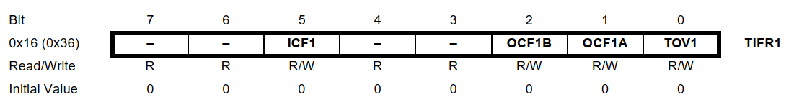
TIFR1 – Timer/Counter1 Interrupt Flag Register
• Bit 7, 6 – Res: Reserved Bits
These bits are unused bits in the ATmega328P and will always read as zero.
• Bit 5 – ICF1: Timer/Counter1, Input Capture Flag
This flag is set when a capture event occurs on the ICP1 pin. When the Input Capture Register (ICR1) is set by the WGM13:0 to be used as the TOP value, the ICF1 Flag is set when the counter reaches the TOP value. ICF1 is automatically cleared when the Input Capture Interrupt Vector is executed. Alternatively, ICF1 can be cleared by writing a logic one to its bit location.

Slide 36
TIFR1 – Timer/Counter1 Interrupt Flag Register
• Bit 4, 3 – Res: Reserved Bits
These bits are unused bits in the ATmega328P, and will always read as zero.
• Bit 2 – OCF1B: Timer/Counter1, Output Compare B Match Flag
This flag is set in the timer clock cycle after the counter (TCNT1) value matches the Output Compare Register B (OCR1B). Note that a Forced Output Compare (FOC1B) strobe will not set the OCF1B Flag. OCF1B is automatically cleared when the Output Compare Match B Interrupt Vector is executed. Alternatively, OCF1B can be cleared by writing a logic one to its bit location.

Slide 37
TIFR1 – Timer/Counter1 Interrupt Flag Register
• Bit 1 – OCF1A: Timer/Counter1, Output Compare A Match Flag
This flag is set in the timer clock cycle after the counter (TCNT1) value matches the Output Compare Register A (OCR1A). Note that a Forced Output Compare (FOC1A) strobe will not set the OCF1A Flag. OCF1A is automatically cleared when the Output Compare Match A InteOCF1A can be cleared by writing a logic one to its bit locationrrupt Vector is executed. Alternatively,.
• Bit 0 – TOV1: Timer/Counter1, Overflow Flag
The setting of this flag is dependent on the WGM13:0 bits setting. In Normal and CTC modes, the TOV1 Flag is set when the timer overflows.
Flag behavior when using another WGM13:0 bit setting. TOV1 is automatically cleared when the Timer/Counter1 Overflow Interrupt Vector is executed. Alternatively, TOV1 can be cleared by writing a logic one to its bit location.

Slide 38
500 ms Blink Example Code using Timer1 Interrupts
Timer 1 is used here. The values of TCCR1A and 1B are reset to 0 to make sure everything is clear. TCCR1B was set equal to 00000100 for a prescalar of 256. If you want to set ones, an OR operation can be used. If you want to set zeros, an AND operation can be used. The compare match mode for the OCR1A register is enabled. For that, the OCIE1A bit was set to be a 1 and that’s from the TIMSK1 register. So, we equal that to OR and this byte 00000010.
The OCR1A register was set to 31250 value so that we will have an interruption each 500ms. Each time the interrupt is triggered, we go to the related ISR vector. Since we have 3 timers, we have 6 ISR vectors, two for each timer and they have these names:
TIMER1_COMPA_vect,
TIMER1_COMPB_vect,
TIMER2_COMPA_vect,
TIMER2_COMPB_vect,
TIMER0_COMPA_vect,
TIMER0_COMPB_vect

Slide 39
500 ms Blink Example Code using Timer1 Interrupts
Timer 1 and compare register A was used so we need to use the ISR TIMER1_COMPA_vect. So below the void loop, the interruption routine is defined. Inside this interruption, the state of the LED was inverted, and a digital write was created. But first, the timer value was reset. Otherwise, it will continue to count up to its maximum value. So, for each 500 ms, this code will run and invert the LED state and that creates a blink of the LED connected to pin D5, for example.

Slide 40
500 ms Blink Example Code using Timer1 Interrupts and Pre-scalar values of 256
We use the pre-scalar value of 256 to reduce the timer clock frequency to 16 MHz/256 = 62.5 kHz, with a new timer clock period = 1/62.5 kHz = 16 μs. Thus, the required timer count = (500,000 μs/16 μs) – 1 = 31,250 – 1 = 31,249. So, this is the value that we should store in the OCR register.
The program for Arduino is as follows:
bool LED_State = ‘True’;
void setup() {
pinMode(13, OUTPUT);
cli(); // stop interrupts till we make the settings
TCCR1A = 0; // Reset the entire A and B registers of Timer1 to make sure that
TCCR1B = 0; // we start with everything disabled.

Slide 41
500 ms Blink Example Code using Timer1 Interrupts and Pre-scalar values of 256
TCCR1B = 0b00000100; // Set CS12 bit of TCCR1B to 1 to get a prescalar value of 256.
TIMSK1 = 0b00000010; // Set OCIE1A bit to 1 to enable compare match mode of A reg.
OCR1A = 31250; // We set the required timer count value in the compare register, A
sei(); // Enable back the interrupts
}
void loop() {
// put your main code here, to run repeatedly.
}
// With the settings above, this ISR will trigger each 500 ms.
ISR(TIMER1_COMPA_vect){
TCNT1 = 0; // First, set the timer back to 0 so that it resets for the next interrupt
LED_State = !LED_State; // Invert the LED State
digitalWrite(13, LED_State); // Write this new state to the LED connected to pin D5
}

Slide 42
External Interrupts
External interrupts triggered by:
INT0 or INT1 pins
Any of the PCINT23:0 pins
INT0 and INT1 are mapped with the pins PD2 and PD3 on ATMega328P
PD2 and PD3 are mapped with digital pins 2 and 3 (GPIO) on the Arduino Uno board
PCINT23:0 are mapped with ports B, C, and D on the Arduino Uno board
Implies any of the I/O pins on the board can be configured to handle interrupts
These interrupts can be used to wake up the processor from sleep modes

Slide 43
External Interrupts
INT0 and INT1 are referred to as ‘External Interrupts’
Can be triggered by a rising edge, falling edge, logical change, or low level
PCINT23:0 are referred to as ‘Pin Change Interrupts’
External interrupts have a higher priority
External interrupts have their own interrupt vectors
Pin change interrupts share interrupt vectors
The interrupt handler has to decide which pin the interrupt originated from

Slide 44

EICRA – External Interrupt Control Register A
Contains control bits for interrupt sense control
Bits 7:4 – Reserved bits – always read as 0
Bits 3:2 – ISC11, ISC10 - Interrupt Sense Control 1
Bits 1:0 – ISC01, ISC00 – Interrupt Sense Control 0
ISC1x corresponds to INT1
ISC0x corresponds to INT0

Slide 45
EICRA – External Interrupt Control Register A
External Interrupts activated by the external pin INT1 or INT0 if the SREG I-flag and the corresponding interrupt mask are set.
Level/edge on INT1/INT0 pin which activates interrupts:
ISCx1 | ISCx0 | Description
0 | 0 | Low level of INT1/INT0 generates interrupt request
0 | 1 | Any logical/level change on INT1/INT0 generates interrupt request
1 | 0 | Falling edge of INT1/INT0 generates interrupt request
1 | 1 | Rising edge of INT1/INT0 generates interrupt request

Slide 46
EICRA – External Interrupt Control Register A
Value of the pin is sampled before detecting the edges
If edge or toggle interrupt is selected:
Pulses longer than 1 clock period will generate an interrupt
Shorter pulses are not guaranteed to generate an interrupt
If low-level interrupt is selected, to generate interrupt:
Low level must be held until the completion of currently executing instruction

Slide 47
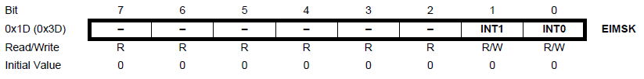
EIMSK – External Interrupt Mask Register
Bits 7:2 – Reserved – always read as 0
Bit 1 – INT1: External Interrupt Request 1 Enable
Bit 0 – INT0: External Interrupt Request 0 Enable

Slide 48
EIMSK – External Interrupt Mask Register
When INT1/INT0 bit is enabled, and I bit (bit 7) of SREG is enabled:
External pin interrupt is activated
ISCx1, and ISCx0 pins in EICRA define whether the external interrupt will be activated on:
Rising edge
Falling edge
Logic change
Low level
Activity on the pin will cause an interrupt even if the pin is configured as an output
Executed from INT1/INT0 interrupt vector

Slide 49
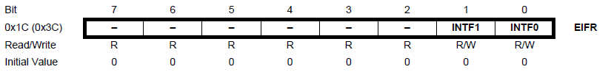
EIFR – External Interrupt Flag Register
Bits 7:2 – Reserved – always read as 0
Bit 1 – INTF1: External Interrupt Flag 1
Bit 0 – INTF0: External Interrupt Flag 0

Slide 50
EIFR – External Interrupt Flag Register
When the INTx pin triggers an interrupt request, INTFx is set
If I bit in SREG and INTx bit in EIMSK are set, MCU will jump to a relevant interrupt vector
INTFx cleared when:
Interrupt routine is executed
A logical 1 is written (cancel any falling interrupts)
Always cleared when INTx is configured as a level interrupt

Slide 51
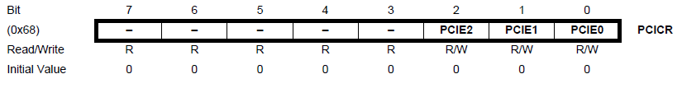
PCICR – Pin Change Interrupt Control Register
Bits 7: 3 – Reserved – always read as 0
Bit 2 – PCIE2 – Pin Change Interrupt Enable 2
Bit 1 – PCIE1 – Pin Change Interrupt Enable 1
Bit 0 – PCIE0 – Pin Change Interrupt Enable 0

Slide 52
PCICR – Pin Change Interrupt Control Register
If PCIEx is enabled and I bit in SREG is enabled, pin change interrupt x is enabled
PCINT 23:16 corresponds to pin change interrupt 2
PCINT 14:8 corresponds to pin change interrupt 1
PCINT 7:0 corresponds to pin change interrupt 0
The pins are enabled individually from PCMSKx register
Executed from PCIx interrupt vector
Any change in these pins will cause an interrupt

Slide 53
PCICR – Pin Change Interrupt Control Register
PCINT 23:16 –
PD7:PD0 on ATMega328P
Pins D7:D0 (GPIO) on Arduino Uno board
PCINT 14:8 –
PC6:PC0 on ATMega328P
PC5:0 – Pins A5:A0 on Arduino Uno board
PC6 – Reset pin on Arduino Uno Board
PCINT 7:0 –
PB7:PB0 on ATMega328P
PB5:0 – Pins D13:D8 on Arduino Uno board
PB6 and PB7 are not available externally on the Arduino Uno board

Slide 54
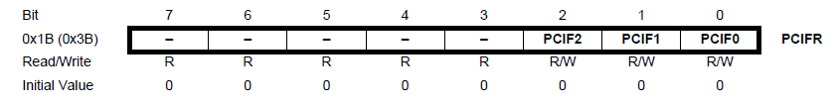
PCIFR – Pin Change Interrupt Flag Register
Bits 7:3 – Reserved – Always read as 0
Bit 2 – PCIF2 – Pin Change Interrupt Flag 2
Bit 1 – PCIF1 – Pin Change Interrupt Flag 1
Bit 0 – PCIF0 – Pin Change Interrupt Flag 0

Slide 55
PCIFR – Pin Change Interrupt Flag Register
Any logic change on PCINT23:0 triggers an interrupt request: PCIFx set
If I bit in SREG and PCIEx on PCICR are set, MCU will go to the corresponding interrupt vector
Flag is cleared when:
Interrupt routine is executed
A logical 1 is written

Slide 56
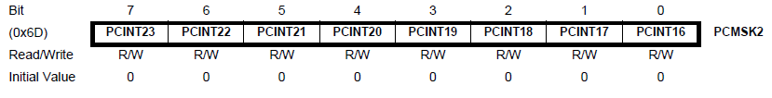
PCMSK2 – Pin Change Mask Register 2
Bits 7:0 – PCINT23:16 – Pin Change Enable Mask 23:16
Each bit selects whether the pin change interrupt is enabled on the corresponding I/O pin
If any bit from PCINT23:16 is set and the PCIE2 bit on PCICR is set, pin change interrupt is enabled on the corresponding I/O pin
If PCINT23:16 is cleared, the pin change interrupt on the corresponding I/O pin is disabled

Slide 57
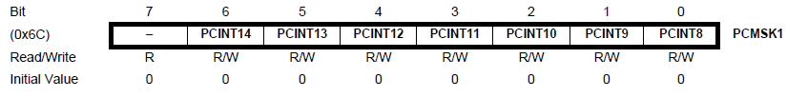
PCMSK1 – Pin Change Mask Register 1
Bit 7 – Reserved – Always read as 0
Bits 6:0 – PCINT14:8 – Pin Change Enable Mask 14:8
Each bit selects whether the pin change interrupt is enabled on the corresponding I/O pin
If any bit from PCINT14:8 is set and the PCIE1 bit on PCICR is set, pin change interrupt is enabled on the corresponding I/O pin
If PCINT14:8 is cleared, the pin change interrupt on the corresponding I/O pin is disabled

Slide 58
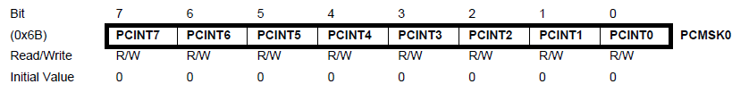
PCMSK0 – Pin Change Mask Register 0
Bits 7:0 – PCINT7:0 – Pin Change Enable Mask 7:0
Each bit selects whether the pin change interrupt is enabled on the corresponding I/O pin
If any bit from PCINT7:0 is set and the PCIE0 bit on PCICR is set, pin change interrupt is enabled on the corresponding I/O pin
If PCINT7:0 is cleared, the pin change interrupt on the corresponding I/O pin is disabled

Slide 59
References
ATMega328 Datasheet
Arduino Uno Datasheet
Chapter 5: Microprocessors, Advanced Industrial Control Technology by Peng Zhang
http://www.ganssle.com/debouncing-pt2.htm
https://mansfield-devine.com/speculatrix/2018/04/debouncing-fun-with-schmitt-triggers-and-capacitors/
https://www.arxterra.com/10-atmega328p-interrupts/
https://www.arxterra.com/11-atmega328p-external-interrupts/
http://www.gammon.com.au/forum/?id=11488

Slide 60
Thanks for attending….
?

